Slide 1


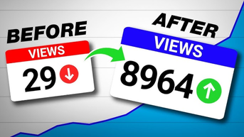

DECODING
VIRALITY
UNPROJECT IDEA
LINUS
LIZ

Slide 2

Contents
01.
Introduction
02.
Scope & Aims
03.
Data & Resources
04.
Techniques
05.
Values & Ethics
06.
Workplan & Timeline

Slide 3


INTRODUCTION
In today’s digital world, going viral is a huge phenomenon that can shape trends and influence millions. For our unproject, we wanted to explore the realms of virality on YouTube and understand what it is exactly that makes a video go viral

Slide 4

SCOPE
Building on our deep analysis and understanding of virality to decipher the key elements that lead to virality, we aim to develop an AI-driven consultancy model tailored to YouTubers to enhance the virality of their videos. We chose YouTube because of its longer viewer engagement times

Slide 5

AIMS
-Determine key factors of a viral video and why those impact virality
-Train an AI model to analyze and predict long term virality
-Establish a consultancy firm where skilled human consultants use the AI model as a tool
-Consultants will provide personalized, strategic guidance and advice to their clients
-Eventually expand beyond YouTube

Slide 6
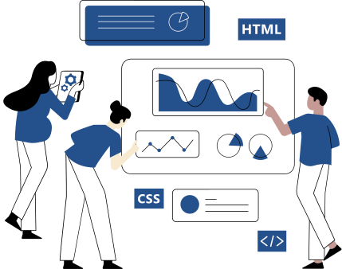
DATA
-Viral Video Data: Gather the data of 100,000 viral YouTube videos that have over 10M+ views each; Note the video length, thumbnails, view count over time, subscriber growth
-Metadata: Collect associated metadata, such as publication date, content category, hashtags, etc
-Viewer Engagement: What patterns can be observed from the comments, likes, and shares?
-Observe Associated Trends: How does it align with current trends or events at the time of its peak virality?
-Crowdsourcing: Collect personal opinions through survey crowdsourcing

Slide 7
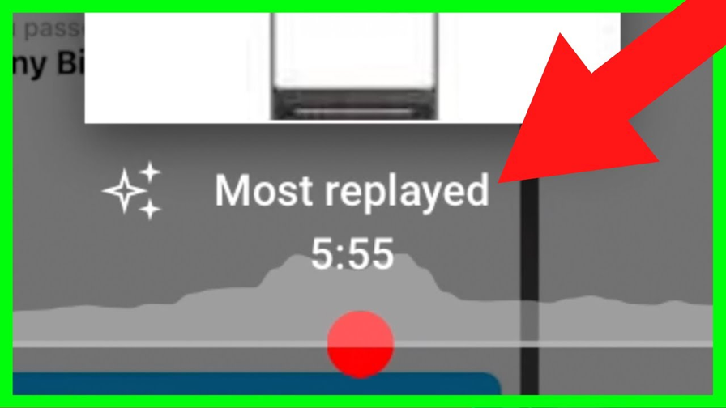

TECHNIQUES
-Frame by Frame analysis using Computer Vision
-Most replayed
-Thumbnails (Orange data mining)
-Analyzing trends on posting times
-Analyzing shares & networking
-Predictive Machine Learning & AI
-Data Visualization
-Text Analysis on titles & comments

Slide 8

RESOURCES DURING...
Creation Process:
-Internet Users for Crowdsourcing
-Software Engineers
-Data Analysts
Final Service:
-Completed AI Model
-Human Social Media Consultants
-Digital Marketing Strategists
-Content Creator Clients
-UI Designers

Slide 9

WORKPLAN
Our vision is to build an AI model that can be of service to our social media consultant firm. The AI model will scan and analyze which parts of the creator’s video are likely to become successful and which parts are likely to be unsuccessful, and our consultants will discuss these analytics with the creator. From there, creators will get personalized one-on-one human guidance to improve their work to increase the chances of virality.

Slide 10
Unproject Timeline
2024
2026
2028
2030
Research Begins:
Collect the data from YouTube using APIs, qualitative data from surveys and interviews with creators, clean and organize data
Analysis:
-Analyze and study the data using advanced analytic tools to find and predict patterns and trends in textual and visual data
-Begin to develop AI model prototypes
Test Run:
-Refine AI models and launch a beta version
-Crowdsource and reach out to creators interested in participating
-Use feedback to expand and enhance AI accurancy, improve UI, and further ensure privacy protections
Official Launch:
-Finalize checks and trainings
-Establish a support team
-Market the service
-Officially launch it
-Actively monitor system performance and user satisfaction
-Plan expansion

Slide 11

VALUES & ETHICS
-No use of Generative AI
-Allow our services to enhance virality while maintaining personalized and human-centric consultance rather than linear AI feedback
-Be transparent about how our services work and what they use
-Respect confidential data and privacy
-Hold accountability for our faults
-Ensure Inclusivity & Accessibility
-Avoid & Prevent AI bias

Slide 12

FAQ
Q: Does your service provide a guarantee virality?
A: Utilizing our AI model, our consultation will help perfect all aspects of a video within our control.
Q: Will your service be provided to other platforms such as TikTok?
A: Our initial focus will be on Youtube videos, other platforms is on our agenda for the future.
Q: Is the service provided to videos of all types of languages?
A: At launch, our service will be catered mainly towards English, but we hope to broaden our audience.

